Slide 1

Course Structure
Overview
G/L Journal Posting
Asset Accounting
Key Design Areas
Parallel Valuation Postings and GAAP-to-GAAP Adjustments
Inventory and Product Costing
Postings
Ledger-through Postings and GAAP-to-GAAP Adjustments
Accrual Engine
G/L Clearing
Lease Accounting
Reporting
Postings to Extension Ledgers

Slide 2
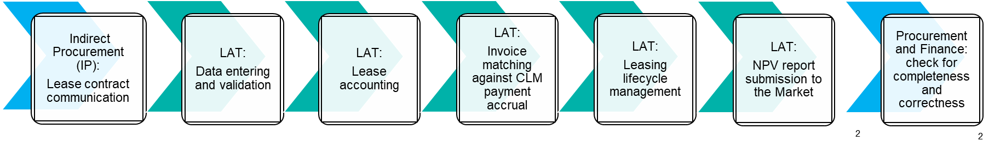
IFRS 16 Lease Accounting Overview
IFRS 16 Accounting standard was effective since January 1st, 2019 with previous operating leases capitalized on the Balance Sheet. Right-of-use (RoU) assets have been created together with Lease liabilities based on the NPV of future payments
Lease accounting process is centrally managed by a dedicated Lease Accounting Team (LAT) in GBS Warsaw with limited involvement on entity side
CLM Lease accounting solution (SAP Contract and Lease Management) is fully integrated with S/4 HANA
The following leases are exempt from capitalization and expensed to P&L:
Short-Term leases with a duration of 12 months or less
Low value leases with an asset value when new less than US$5,000

Slide 3
Lease Accounting Process
1. PO Creation/Contract Submission
2. Review & CLM Data Entry
3a. Postings (IFRS 16 Approach)
4. Invoice matching and follow up (only for 3a & 3b)
Responsibility: | GBS LAT¹⁾
System: | CLM
Responsibility: | Entity IP in liaison with Entity Tax
System: | SAP/MyJTI/ email
Responsibility: | GBS LAT ¹⁾
System: | CLM
Responsibility: | GBS LAT¹⁾
System: | SAP
CLM calculates and posts initial RoU Asset in SAP AA module and Lease Liability in SAP GL for “Capitalized” contracts upon activation.
Exempt lease, Interest accrual and Liability reduction postings are calculated by CLM and posted by LAT in SAP GL at month end. RoU Asset depreciation posting is performed during standard SAP AA depreciation run.
Postings made to relevant ledger/ledger group (IFRS and/or STAT and/or TAX) based on Entity Accounting Approach table where IFRS 16 approach is followed.
Invoices are first posted as “ledger through” to account 243032 based on PO account assignment. For ledgers where IFRS 16 or Accrual approach is followed, the invoice (incl. non-recoverable VAT) is automatically reposted to account 243031 using GR/IR Offset framework.
In account 243031, LAT reconciles / clears invoice received with expected payment amount posted by CLM. In case of differences, follow up with Entity PPO / Entity Finance is performed.
Indirect Procurement (IP) creates the PO using fixed leasing Material Group (for fixed payments) & sends PO reference and contract to LAT via MyJTI
MyJTI also contains Tax Perm Tag (TPT) ID field, which is used for research & development reasons, where applicable, in liaison with Entity Tax team.
Any subsequent contract change (e.g. extension, termination, price increase) must be communicated to LAT via MyJTI and PO Price and/or Quantity updated accordingly.
Deadline – WD-4
LAT reconciles contract & PO information and enters all details including TPT ID in CLM.
Contract terms are assessed by LAT and contract is classified in CLM as “Capitalized” or “Exempt” (Low value / Short Term).
Contract is then activated in CLM by LAT.
3b. Postings (Accrual Approach)
Responsibility: | GBS LAT¹⁾
System: | CLM
CLM postings are modified by LAT to replicate accrual accounting and posted in SAP at month end. No classification of contracts as Capitalized or Exempt - lease charges are posted to P&L lease expense accounts by asset class.
For prepaid contracts, CLM will create and manage Accrual Objects in SAP
Postings made to relevant ledger/ledger group (STAT and/or TAX) based on Entity Accounting Approach table where Accrual approach is followed.
5. NPV report submission to Markets
3c. Postings (Invoice Receipt Approach)
Responsibility: | GBS LAT¹⁾
System: | Email, WD-1
Responsibility: | GBS AP and Entity Finance
System: | SAP
6. Lease postings verification by Markets
Invoice amount (relating to fixed leasing material group) will be posted directly in SAP to P&L Lease expense accounts by asset class simultaneously when the invoice is posted by GBS AP (using GR/IR Offset framework via account 243032).
Entities will need to initiate any other relevant postings locally (e.g. Tax Perm Tagging via Tagging Rules, Prepayments if applicable).
Postings made to relevant ledger/ledger group (STAT and/or TAX) based on Entity Accounting Approach table where IR approach is followed.
Responsibility: | Entity IP/Finance
System: | Email
3
¹⁾ LAT: Lease Accounting Team
Market checks SAP postings/NPV report data for completeness and correctness. LAT corrects the issue (if any) based on the email from the Market.

Slide 4
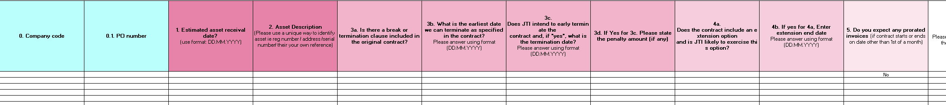
PO Creation/Contract Submission
Prior to WD-4 Market Indirect Procurement (IP) should create all the Purchase Orders (PO) for leased assets
Within the same timelines after the PO creation IP should submit the templates with the lease contracts data to GBS LAT via MyJTI or for JT/non-sap entities through email jtleasecontractforlat@jti.com. Contracts should be attached to the templates.
The template contains the general information regarding the contract e.g., Asset description (always in English), asset type, contract currency, start and end dates of the contract, payment frequency. If the attached contract is in the language different to English or Polish (e.g., Japanese), additional information should be added to the template (see on the next slide)
If the template is submitted to LAT after the deadline, it is considered for the following month postings
The template should be as clear and detailed as possible to avoid misunderstanding, questions from LAT and mistakes in postings
For all leased assets except cars, one template should be created for only one PO. In case one template considers more than 1 asset (one PO with several lines for each asset), it is required to add details for each asset using field for additional notes.
For leased cars, one template can cover several POs of one entity. Templates for leased cars are submitted once per month.
Notes:
Prior to WD-4 Market should create all the Purchase Orders for leased assets
Within the same timelines Markets should submit the templates with the lease contracts data to GBS LAT via email. Contracts should be attached to the templates
The template contains the general information regarding the contract e.g., Asset description (always in English), asset type, contract currency, start and end dates of the contract, payment frequency. If the attached contract is in the language different to English or Polish (e.g., Japanese), additional information should be added to the template (see on the next slide)
If the template is submitted to LAT after the deadline, it is considered for the following month postings.
The template should be as clear and detailed as possible to avoid misunderstanding, questions from LAT and mistakes in postings
One template should be created for only one Purchase Order. In case one template considers more than 1 asset (one PO with several lines for each asset), it is required to add details for each asset using field for additional notes.
Additional slide

Slide 5
PO Creation/Contract Submission
Additional information is requested by GBS LAT for contracts in languages other than English and Polish e.g.:
Is there an extension option for the contract (e.g., if the contract is for 5 years but its already known it can be extended). If YES – details should be provided in the text field
Payment date and period e.g., we pay on the 1st of January for January, or we pay on the 15th of January for the period January 15th – February 15th
Advance or post payment
Number of assets (e.g., there may be 500 vehicles in one Contract and PO). Conditions for all the assets (e.g., values, dates) should be the same
When the 1st invoice should be posted, and payments should start
Is the payment amount fixed or will change during the year. If changes planned – details should be provided in the text field
Are there any deposits, guaranties etc. If YES – detailed should be provided in the text field.
Any legal, transportation, other additional costs planned? If YES - amount and other details should be provided in the text field
Accounting assessment (e.g., if it’s a low value asset)
If contract has an option to replace the asset (e.g., initially we leased BMW, but after a year it was replaced by Volvo)
Can the contract be terminated earlier? If YES, the earliest date when its possible to terminate (non-cancellable period) should be provided in the text field
Is any asset retirement obligation (ARO) planned? If YES, it is required to provide NPV of ARO in the text field
If the minimum NPV of the asset at the end of the leasing period (how much the asset should cost at least) is fixed. If YES, it should be provided in the text field.
Notes:
On this slide you can see additional information requested by GBS LAT for contracts in languages other than English and Polish e.g.:
Is there an extension option for the contract (e.g., if the contract is for 5 years but its already known it can be extended). If YES – details should be provided in the text field
Payment date and period e.g., we pay on the 1st of January for January, or we pay on the 15th of January for the period January 15th – February 15th
Advance or post payment
Number of assets (e.g., there may be 500 vehicles in one Contract and PO). Conditions for all the assets (e.g., values, dates) should be the same
When the 1st invoice should be posted, and payments should start
Is the payment amount fixed or will change during the year. If changes planned – details should be provided in the text field
Are there any deposits, guaranties etc. If YES – detailed should be provided in the text field.
Any legal, transportation, other additional costs planned? If YES - amount and other details should be provided in the text field
Accounting assessment (e.g., if it’s a low value asset)
If contract has an option to replace the asset (e.g., initially we leased BMW, but after a year it was replaced by Volvo)
Can the contract we terminated earlier? If YES, the earliest date when its possible to terminate (non-cancellable period) should be provided in the text field
Is any asset retirement obligation (ARO) planned? If YES, it is required to provide NPV of ARO in the text field
If the minimum NPV of the asset at the end of the leasing period (how much the asset should cost at least) is fixed. If YES, it should be provided in the text field.

Slide 6
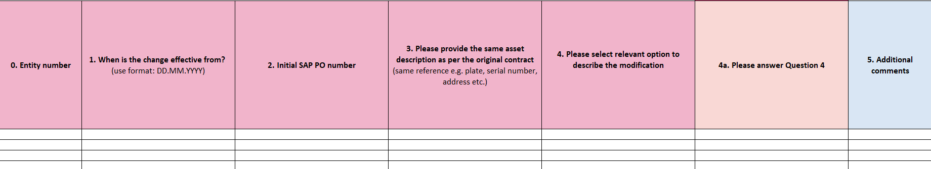
PO Creation/Contract Submission
In case of a contract modification, within the same timelines modifications template (different from initial contract template) is filled out by the Market IP and submitted to GBS LAT via MyJTI or if JT/non-sap through email jtleasecontractforlat@jti.com. Modified contracts should be attached to the templates.
The template contains the general information regarding the contract e.g., Asset description (always in English), PO number. In addition to that it is required to provide the details of the modifications in the form.
Modification templates for leased cars are submitted once per month and can contain several POs for one entity.
Notes:
In case of a contract modification, within the same timelines modifications template (different from initial contract template) is filled out by the JTBC IP and submitted to GBS LAT via email jtleasecontractforlat@jti.com. Modified contracts should be attached to the templates.
The template contains the general information regarding the contract e.g., Asset description (always in English), PO number. In addition to that it is required to provide the details of the modifications in the form.

Slide 7
SAP S/4 impact on Leasing Process - Treatment
CLM
S/4HANA
Lease Accounting Treatment | Ledger | Lease Accounting Approach | Calculations and Accounting entries | Posting of Accounting Entries
 | IFRS | IFRS 16 | Perform calculations and provide accounting entries | GBS LAT: CLM posts generated accounting entries to IFRS Ledger.
 | STAT and/or TAX ¹⁾ | IFRS 16 | Same calculation and accounting entries as above for IFRS | GBS LAT: CLM posts generated accounting entries to the ledger(s) together with the above posting to IFRS ledger.
 | STAT and/or TAX ²⁾ | Accrual | No accrual calculation or postings provided | GBS LAT: 1) CLM posts generated accounting entries to the ledger(s) together with the above posting to Accrual ledger.
 | STAT and/or TAX ³⁾ | Invoice Receipt | No postings will be triggered by CLM | GBS AP: Post Invoices (relating to fixed leasing material group), which is then posted directly against P&L Lease expense accounts by asset class via GR/IR Offset Framework.
1) If you apply IFRS16 approach to either STAT or Tax ledger, or both STAT and Tax ledger.
2) If you apply Accrual approach to either STAT or Tax ledger, or both STAT and Tax ledger.
3) If you apply IR (Invoice Receipt) approach to either STAT or Tax ledger, or both STAT and Tax ledger.

Slide 8

SAP S/4 impact on Leasing Process – Non-deductible Lease expenses
CLM
S/4HANA
Supporting Tagging of Perms in TAX Ledger | Ledger | Lease Accounting Approach | Tagging Non-deductible contracts | Tagging the Perms (Non-deductible P&L items)
 | TAX | IFRS 16 | LAT includes the Tax Perm Tag (TPT) ID (e.g. EXLA001) for relevant Lease contracts where applicable in CLM which is subsequently carried over to the relevant lease expense postings, typically depreciation and/or interest expenses. | Automatic conversion from TPT ID in CLM (e.g. EXLA001) to AA tag (e.g. LA01) upon AA Master Data creation. Upon posting of relevant Asset related P&L transactions, automated conversion back from AA tag to TPT ID (e.g. LA01 to EXLA001) for depreciation. Any interest expense will also be tagged from CLM using the same TPT ID (e.g. EXLA001)
 | TAX | Accrual | LAT includes Tax Perm Tag (TPT) ID (e.g. EXLA001) for relevant Lease contracts where applicable in CLM which is subsequently carried over to the relevant lease expense postings, i.e. rental expense. | 1) No tag is transferred to AA Master data as no RoU asset created 2) Upon posting of rental expense driven by accrual, this rental expense will be tagged from CLM with the relevant TPT ID.
 | TAX | Invoice Receipt | N/A, as in IR based approach postings in SAP do not come from CLM. | No Tax Perm Tagging is done from CLM. Tagging can only be done when running Tax Perm Tagging Cockpit, either manually or automatically via tagging rules.
Details of the Tax Perm Tagging mechanism related to Lease Accounting are further explained in training course System-based Solutions for Corporate Income Tax.

Slide 9
Lease Accounting: Entity Accounting Approach

Slide 10
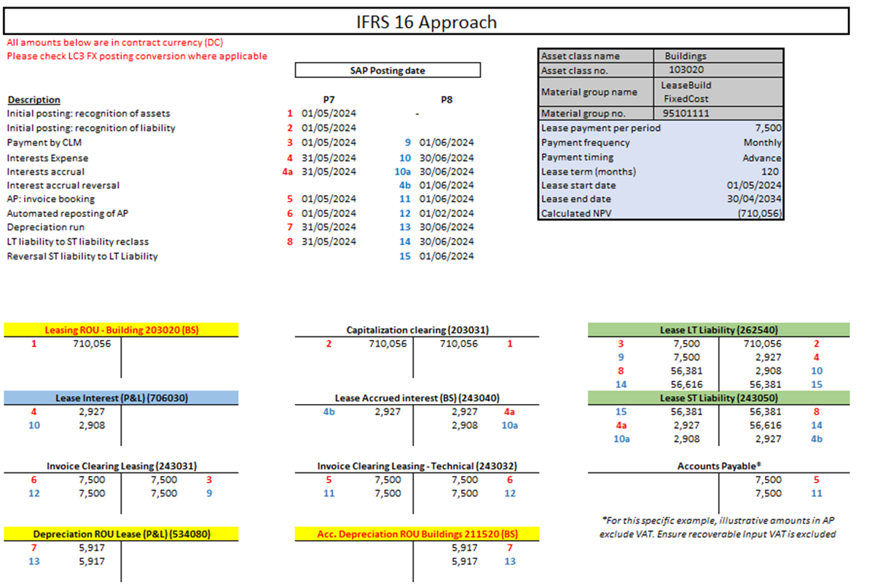
Posting Scheme: IFRS 16 Based

Slide 11
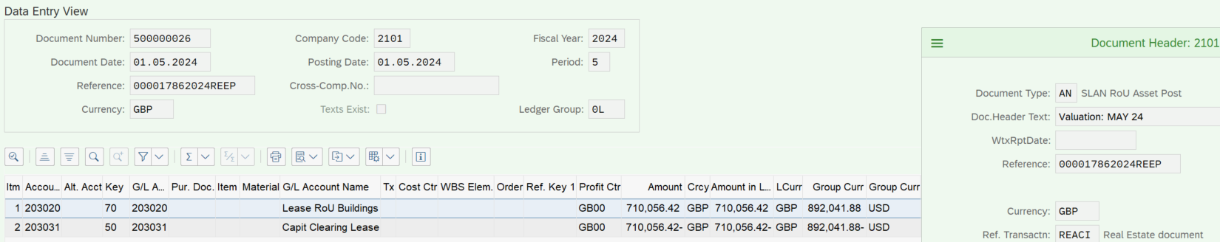
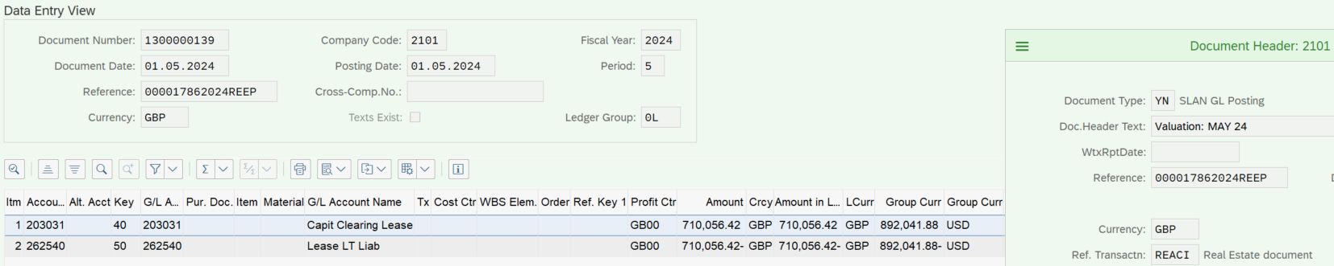
IFRS 16 Based Example: Capitalized contract validation
1. Initial Posting: Recognition of Assets
2. Initial Posting: Recognition of Liability

Slide 12
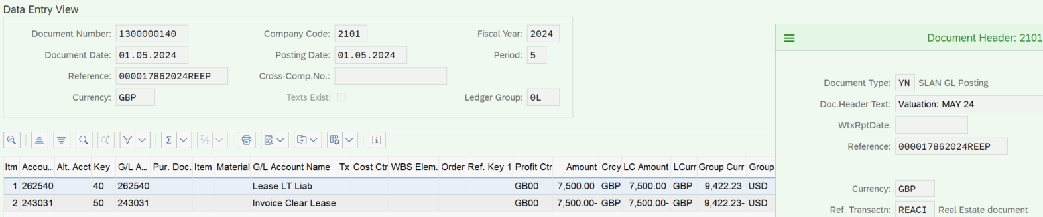
IFRS 16 Based Example: Capitalized contract validation
3. Payment by CLM

Slide 13
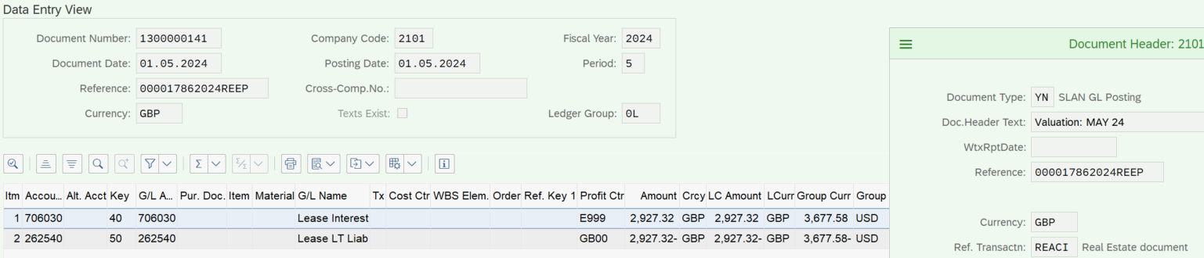
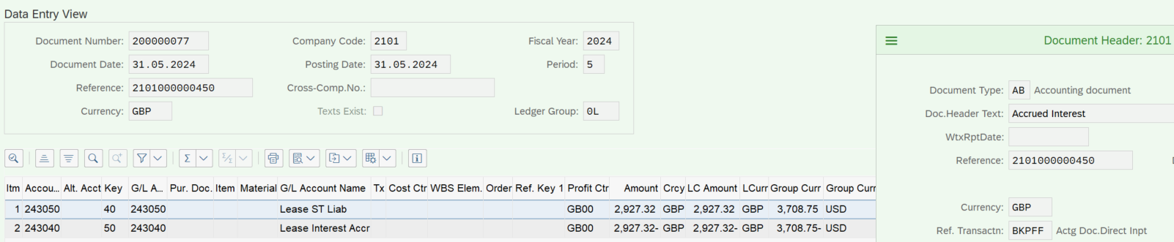
IFRS 16 Based Example: Capitalized contract validation
4. Interest expense
4a. Interest Accrual

Slide 14
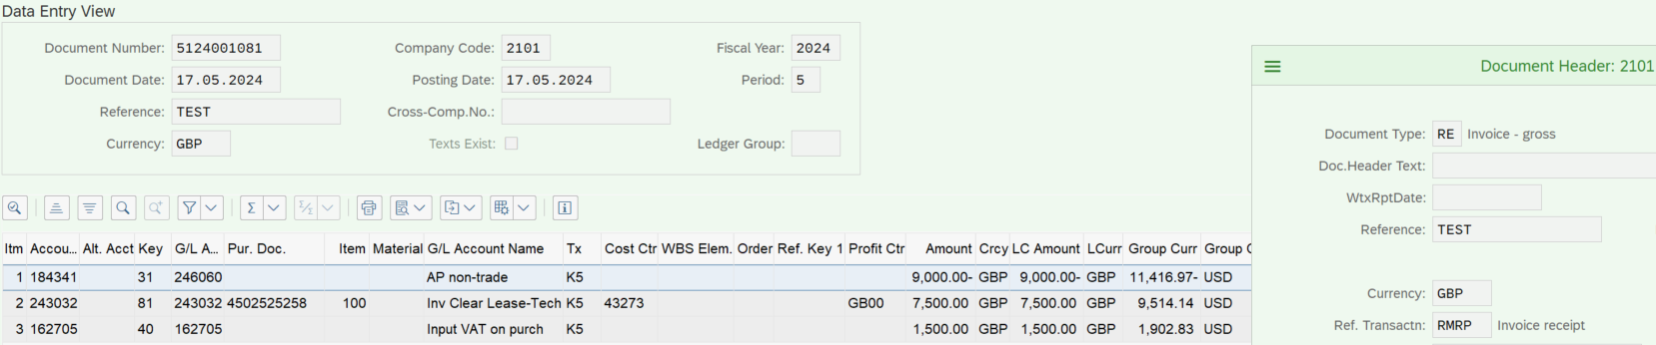
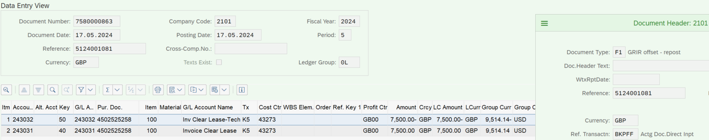
IFRS 16 Based Example: Capitalized contract validation
5. AP Invoice Booking
6. Automated reposting of AP

Slide 15
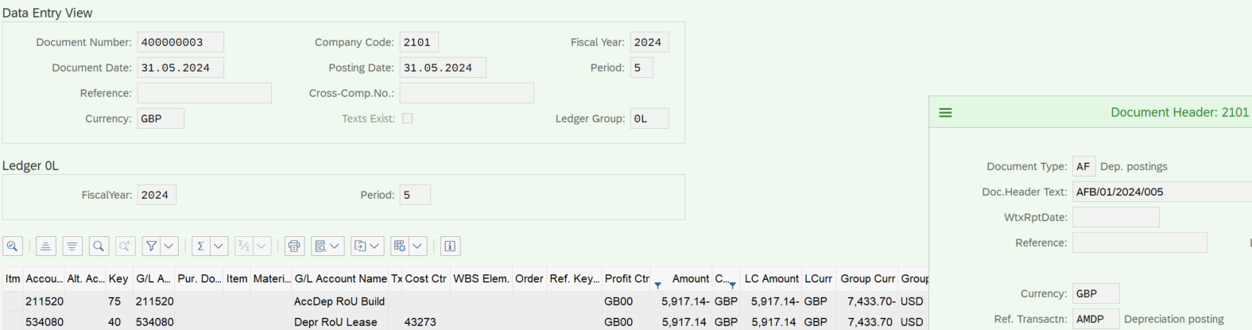
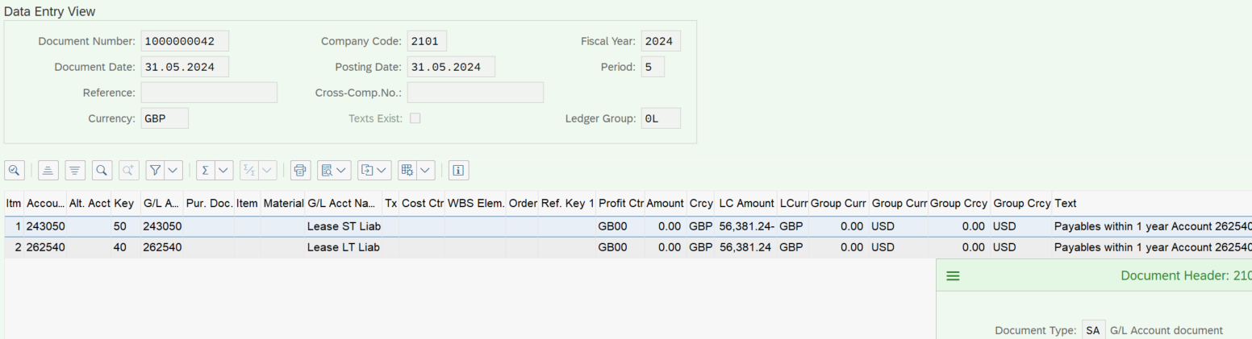
IFRS 16 Based Example: Capitalized contract validation
7. Depreciation Run
8. LT to ST Liability Reclass

Slide 16
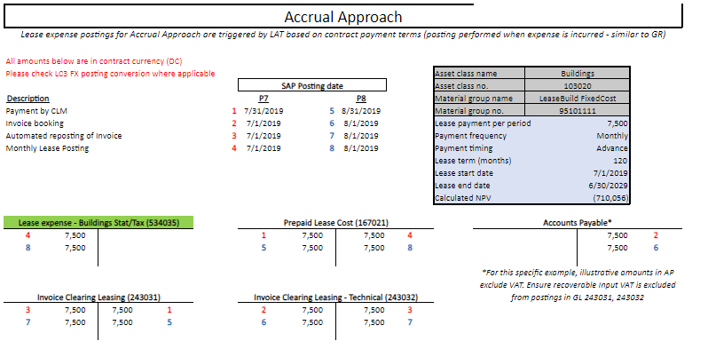
Posting Scheme: Accrual Based

Slide 17
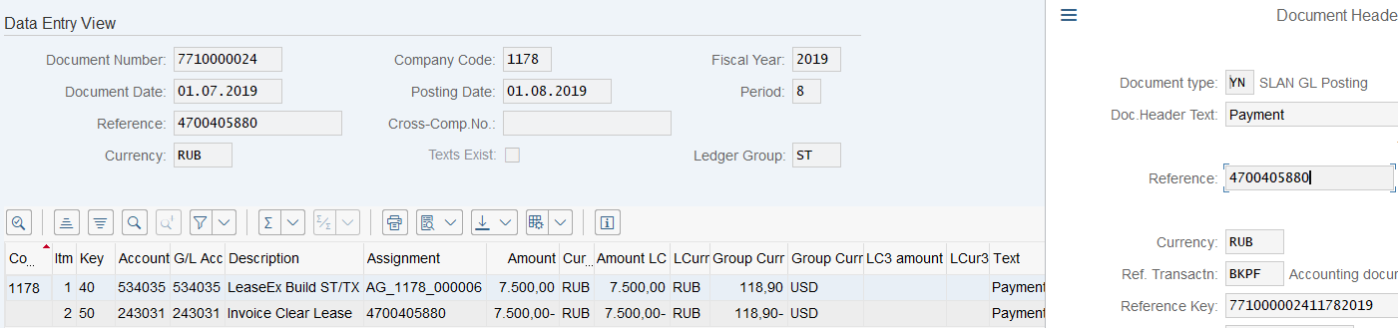
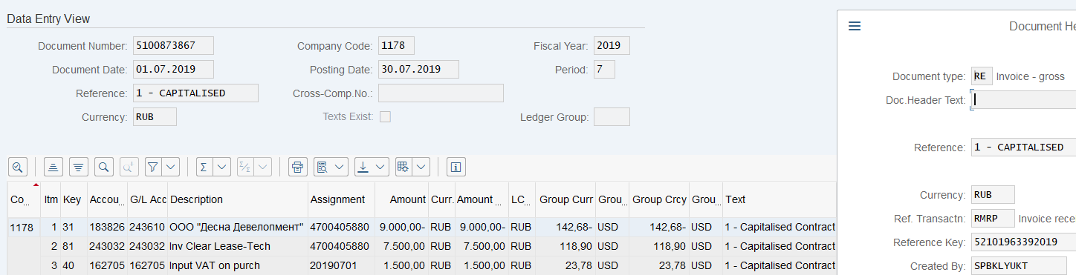
Examples for Accrual based posting scheme
1. Monthly Lease expense posting
2. AP: Invoice booking

Slide 18
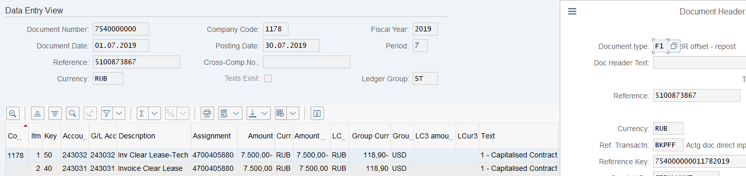
Examples for Accrual based posting scheme
3. Automated reposting of AP

Slide 19
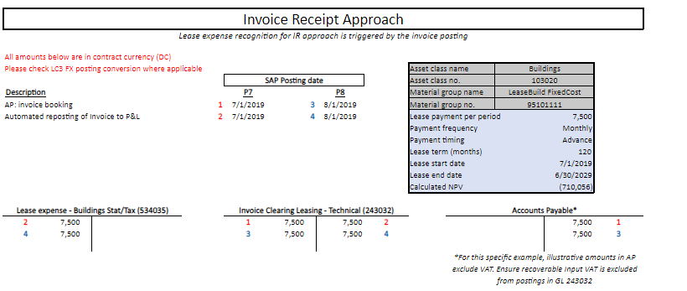
Posting Scheme: Invoice Receipt Based

Slide 20
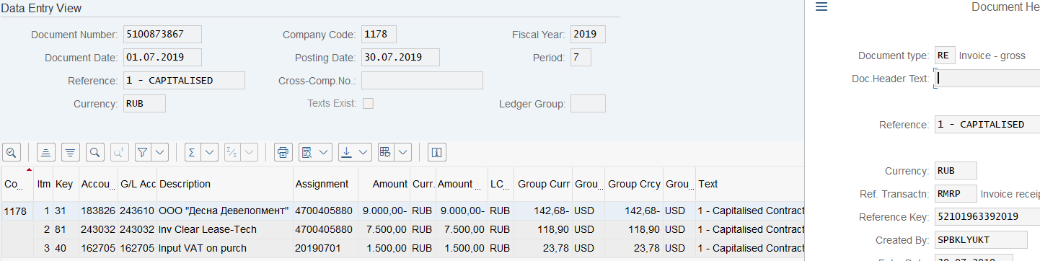
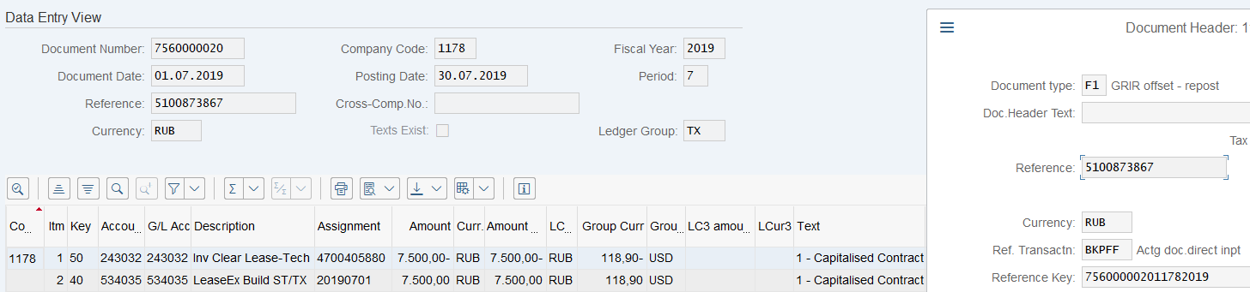
Examples for IR based posting scheme
1. AP: Invoice booking
2. Automated reposting to Invoice to P&L

